Slide 1

McDonald’s Data Analytics Capstone
MKTG 4010 | Spring Q1 2023
Megha Raman

Slide 2
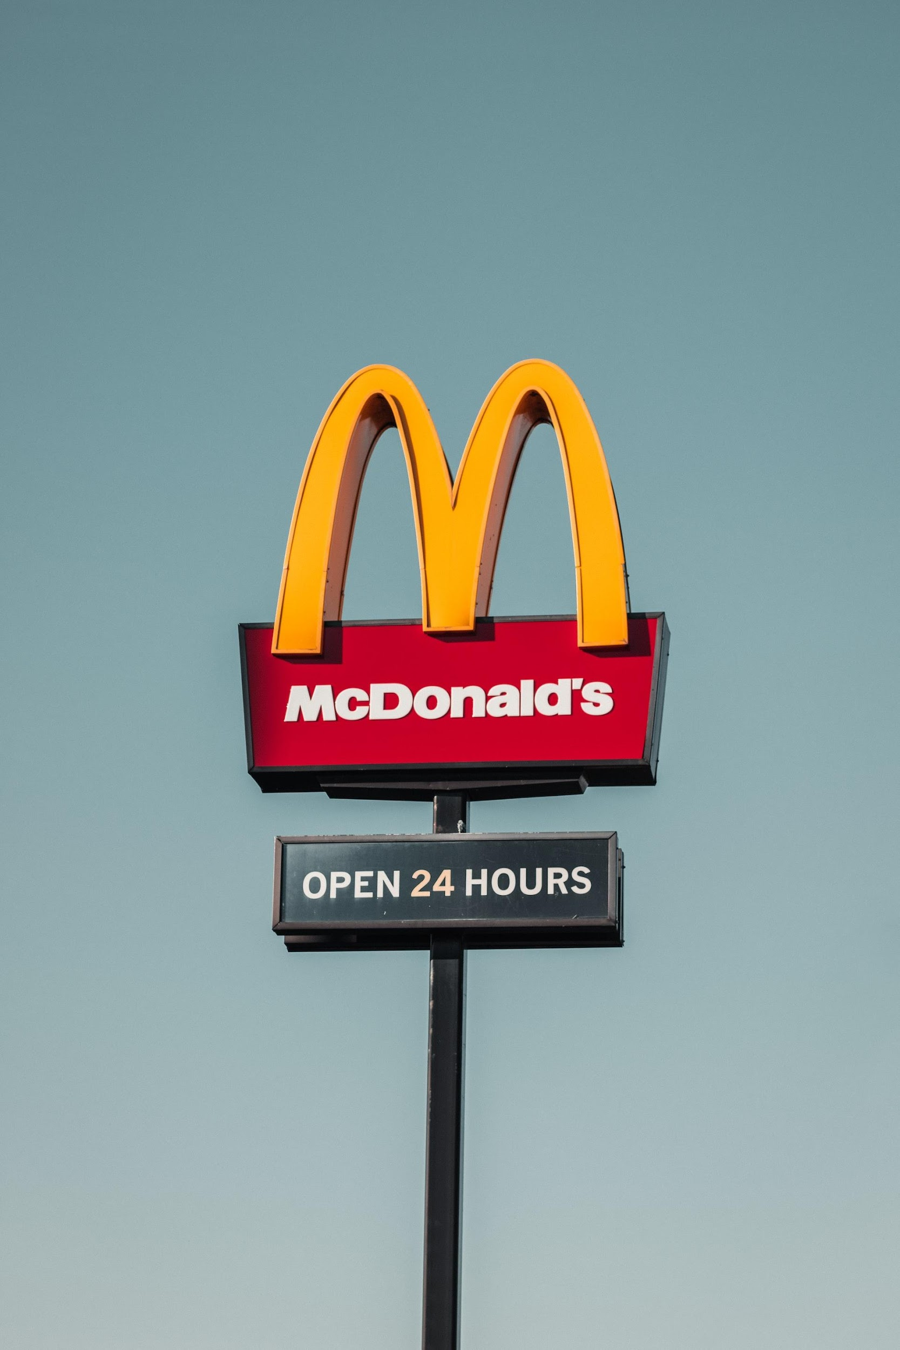
Today’s Agenda
Background
Summary: The Client, The Data, The Problem
Summary: Our Approach and Solutions
Measuring the Impact of COVID-19
Understanding The Approach and The Model
Segmentation
Key Results and Recommendations
Advertising Assessment
Understanding the Approach and the Model
Key Results and Recommendations
Concluding Synthesis and Recommendations
Q&A
Background
COVID Impact
Ad Assessment
Recommendations

Slide 3
Executive Summary: Introducing The Client, The Data, and The Problem
McDonald’s seeks to understand pandemic-driven sales issues and consider advertisement as a revival tool
Our Client: McDonald’s
Quick-serve restaurant (QSR), with focus on convenient menu items and lower prices without table service
No.1 fast food chain, with over 38,000 locations worldwide
Leverages fast food to power real estate-driven profits and the ‘3Ds’ (digital, delivery and drive-thru)
The Key Problem
McDonald’s has faced a myriad of issues as a result of COVID-19. Primarily, McDonald’s is concerned with decreased sales during the pandemic, and the company has attempted to address the issue through advertising. The company would like to understand the effectiveness of advertising as a tool for reviving company sales.
McDonald’s Data over Time
Timeline: Jan. 2018 - Dec. 2020
Daily sales data and customer counts
Sales by COOP (regional)
Breakdown of sales by time of day
Sociodemographic economic data
Media campaigns (Facebook, Twitter, Snapchat, Pinterest)
Our Tasks
Understand the overall impact of COVID on sales
Examine differences in COVID impacts across COOPs
Address the influence of advertisement campaigns on sales
Background
COVID Impact
Ad Assessment
Recommendations

Slide 4
Executive Summary: Our Approach and Solutions
We leveraged predictive modeling tools to understand the impact of COVID-19 and advertising on sales
Data Used
Models and Tools
Core Output Metrics
Segmentation
COVID Impact Assessment
Sales by meal
Guest count
Python
Random Forest
Predictive Model of Total Sales
Accuracy Metric
U.S. regions
Metro vs. non-metro areas
No. of weekly advertising campaigns
Seasonality Variable: Quarter
Clustering on total sales
Metro vs. non-metro areas
Advertising Assessment
JMP Regression Analysis
Predictive Model of Weekly Total Sales
Accuracy Measure
Careful selection of inputs dictates model accuracy and interpretation
Predictive tools are useful in generating comparative baselines to assess impact
Total sales enables analysis of economic impact but limits insight into transaction size and quantity
Segmentation allows for more nuanced perspectives and tailored solutions
Takeaways
Overall Recommendation: The utilization of data analytics tools can better help analyze the impact of demand shocks to McDonalds’ core business model.
Background
COVID Impact
Ad Assessment
Recommendations

Slide 5
Measuring the Impact of COVID-19 on Sales at McDonald’s

Slide 6
Understanding Our Approach and Model: Machine Learning Random Forest Model
We used a ML model to predict future sales in order to provide a baseline for understand the impact of COVID-19
Model Inputs
Model Machinery
Model Outputs
Encoded categorical variables (region, store count)
Month, Day, and number of sales
Random forest is a collection of individual, uncorrelated decision trees.
Random forest is time agnostic but can capture seasonality
The key dependent variable is daily total sales amount. For each region, the model will predict what daily total sales would have been in the absence of COVID-19.
Relationship to the Core Problem
We used a random forest model trained on pre-COVID (March 11, 2020) to predict the total daily sales amount for each segment after March 11, 2020. This allowed us to predict what sales would have been if COVID-19 had not occurred. By then taking the difference between predicted and actual values (subtracting out model error) after March 11, 2020, and summing up each individual difference, we could assess the impact of COVID-19 on sales. We performed this across two segments: regions (Northeast, South, Midwest, West) and communities (metro vs. non-metro).
Background
COVID Impact
Ad Assessment
Recommendations

Slide 7
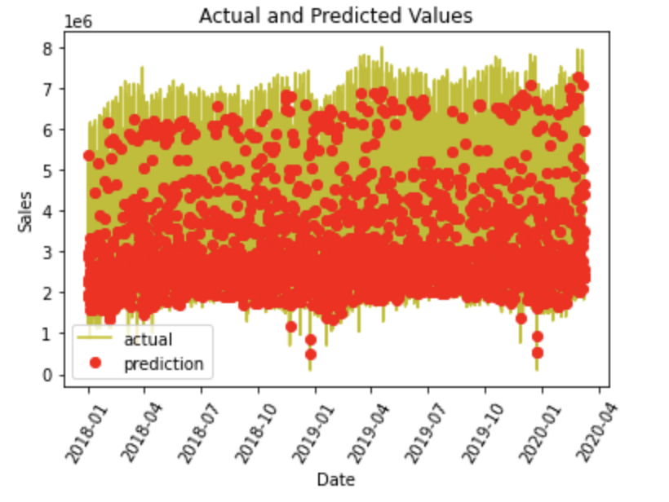
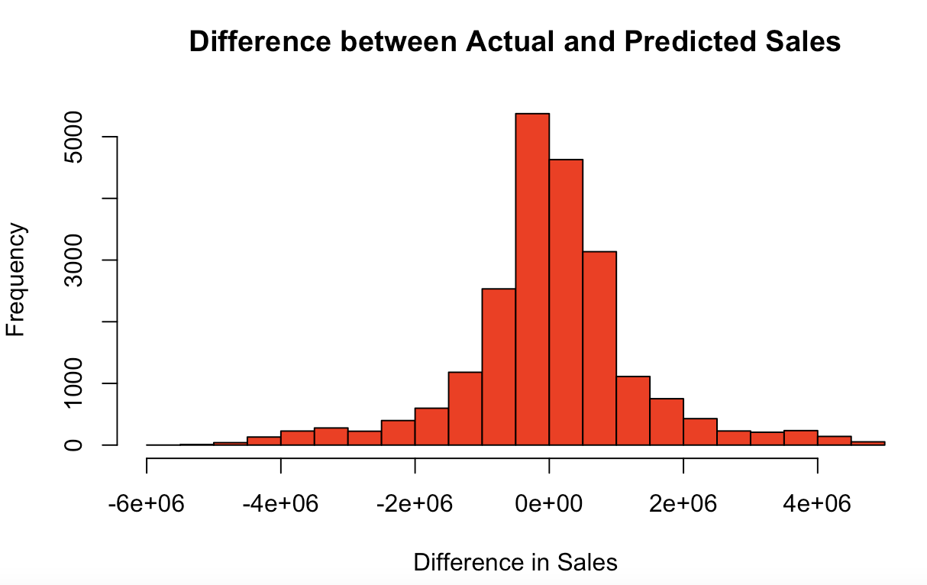
Understanding Our Approach and Model: Machine Learning Random Forest Model
We used a ML model to predict future sales in order to provide a baseline for understanding the impact of COVID-19
Model Features | Time agnostic data: did not use time as a linear function of the model, rather inputs to capture seasonality Training and test data: random assignment from January 1st, 2018 to March 10th, 2020 (official U.S. declaration of COVID)
Model Accuracy | Mean Absolute Percent Error: 0.1357 Accuracy: 86.43%
Background
COVID Impact
Ad Assessment
Recommendations

Slide 8
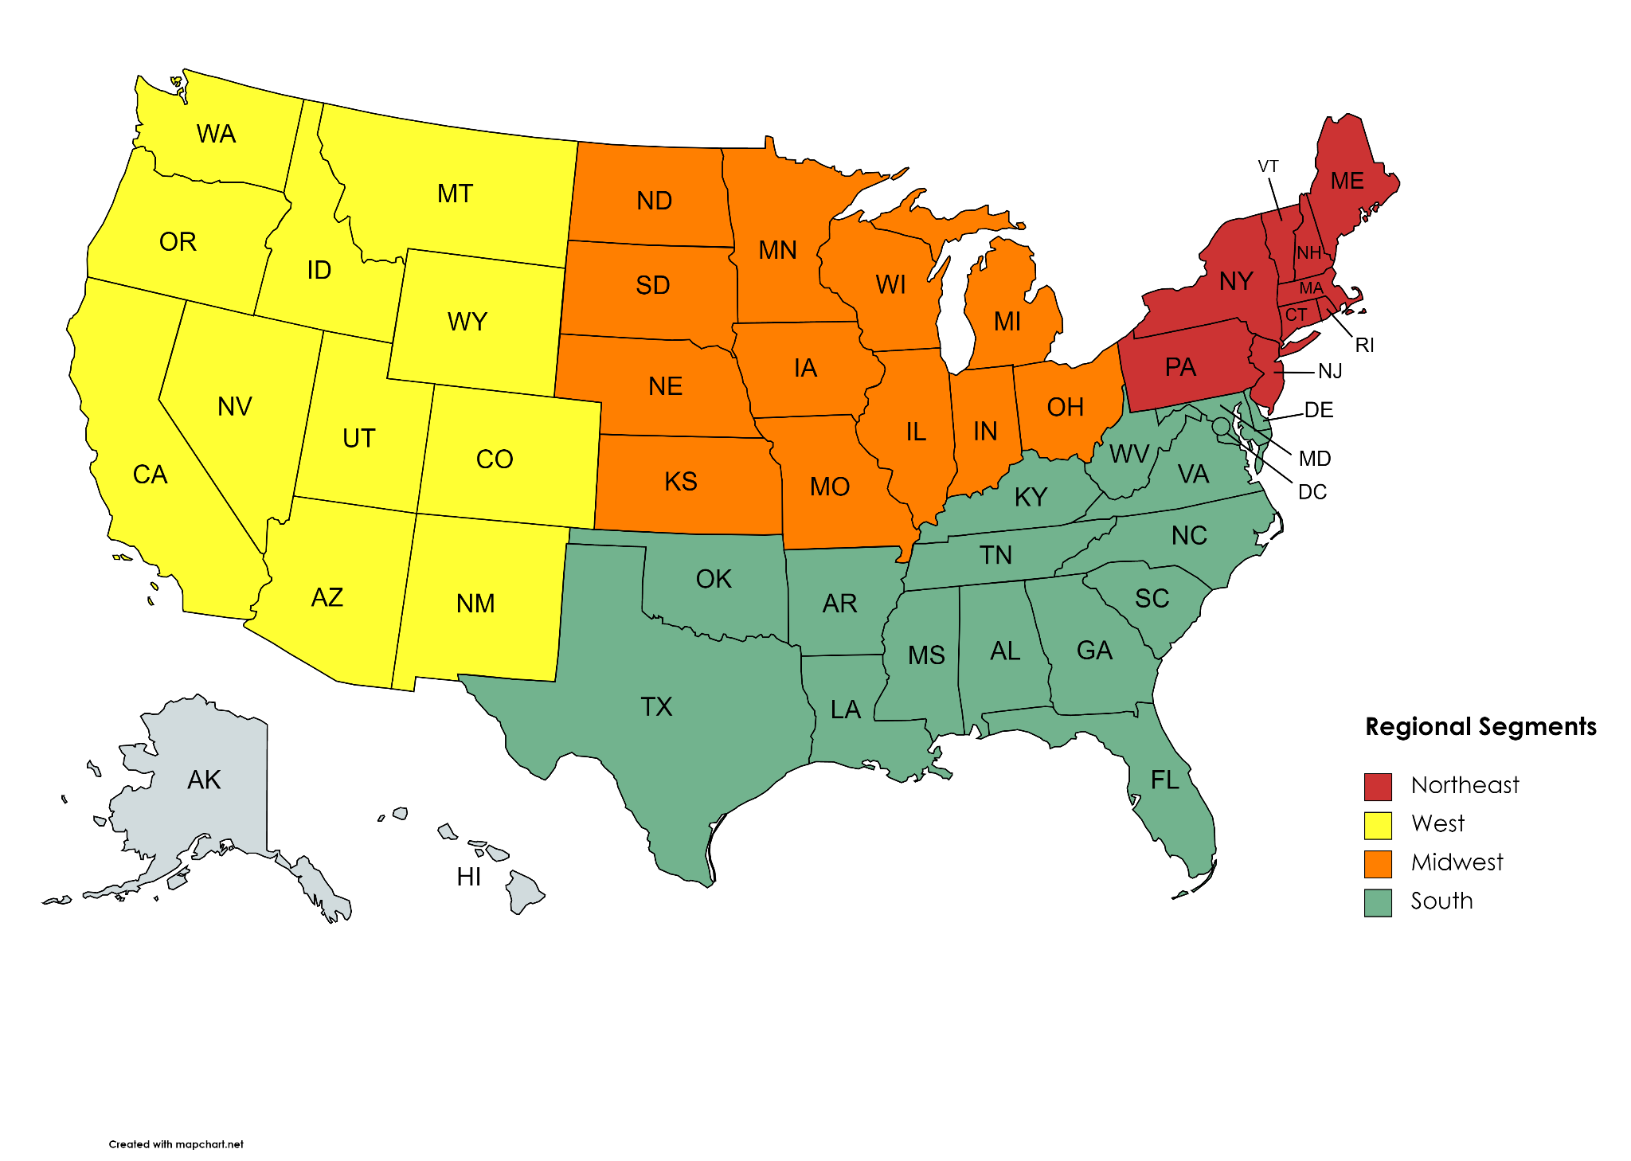
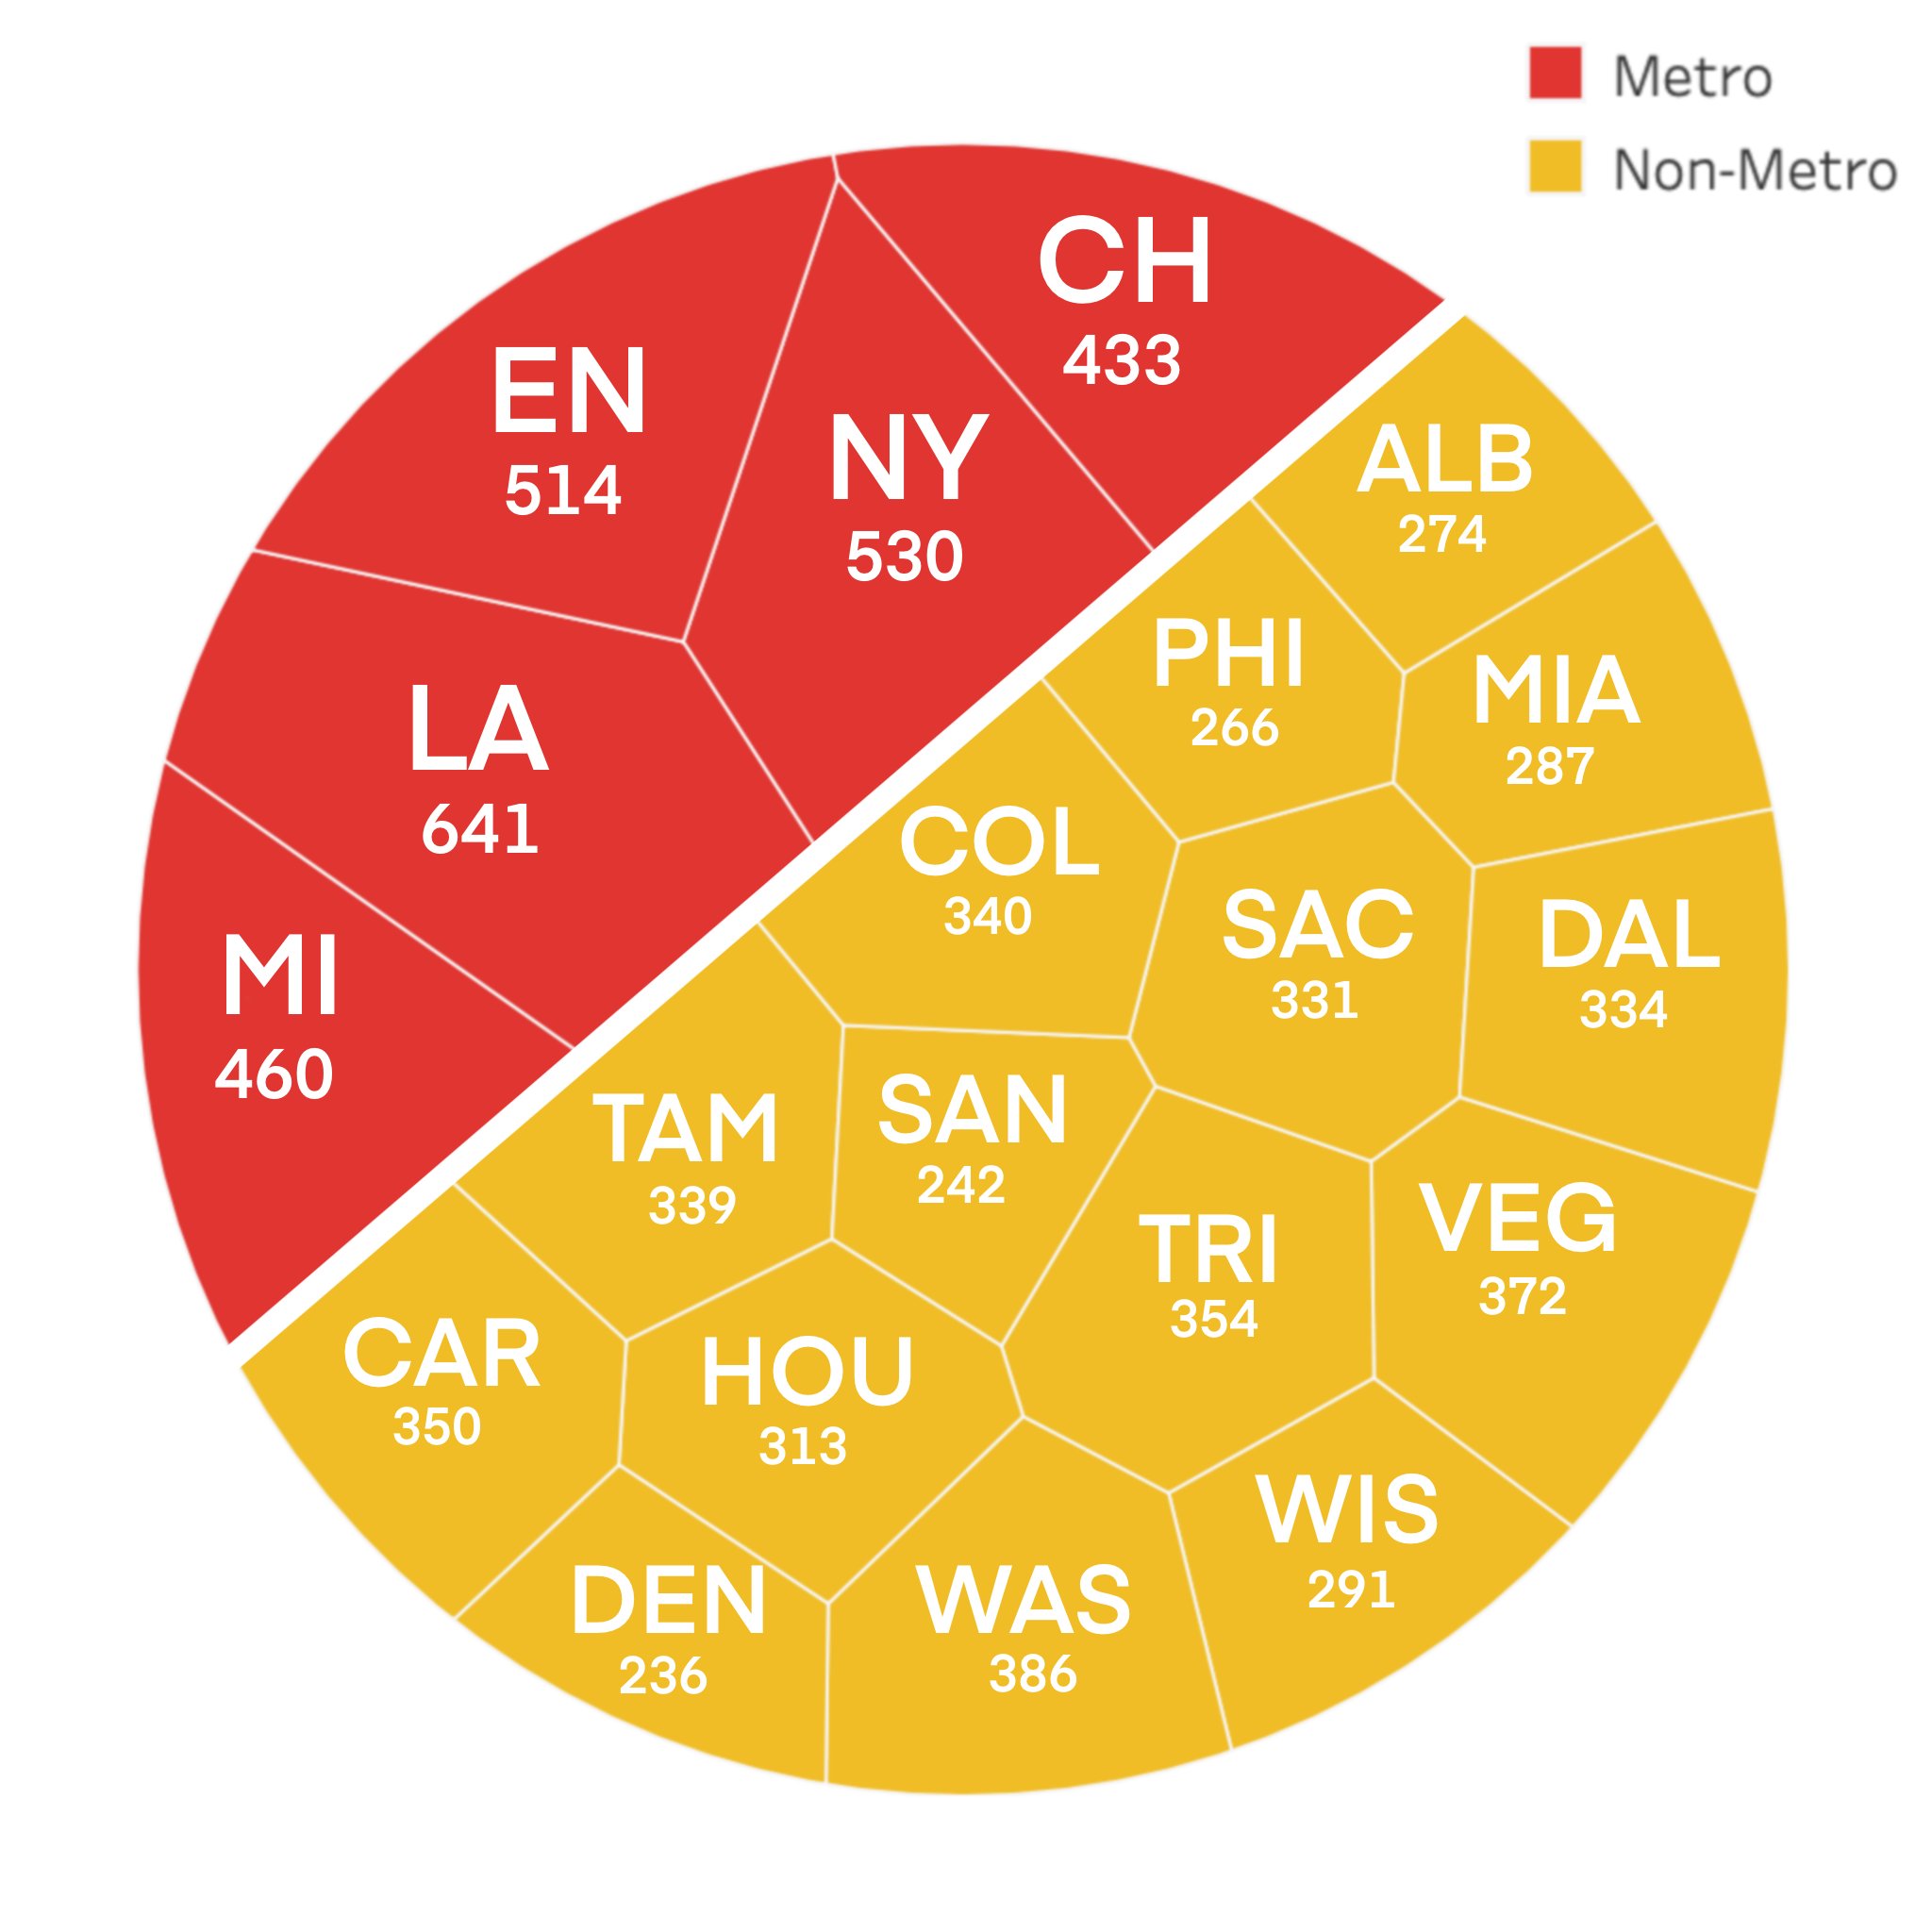
Using Segments to Gain a Nuanced Understanding of the Impact of COVID-19 on Sales
We used both a-priori and clustering model segmentation to analyze the impact of COVID on various geographies
Segmentation Strategy
We analyzed segmentation under two dimensions: a-priori grouping by region (West, Midwest, South, and Northeast) and grouping by store count to distinguish metro and non-metro areas.
Analyzing across segments would allow us to understand which geographies and types of customers (urban vs. rural) were most impacted by COVID-19
A more nuanced perspective would allow us to provide tailored solutions for each segment
Dimension 1: Region
Dimension 2: Metro vs. Non-Metro
Background
COVID Impact
Ad Assessment
Recommendations
Notes:
Appendix: Add additional segmentation considerations

Slide 9
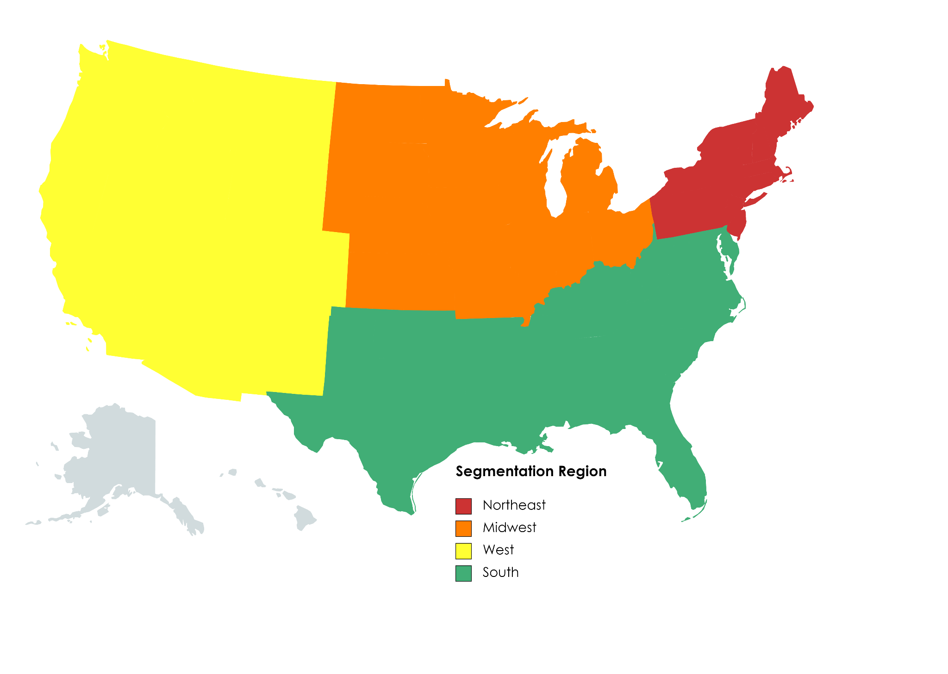
Assessment of the Impact of COVID-19 on Total Sales by Region
We estimate COVID-19 resulted in an approximate $377M loss in total sales across all COOPs in the data set
Estimated Total Losses Due to COVID-19 by U.S. Region
3/11/2020 - 12/31/2020
Estimated Average Daily Losses Due to COVID-19 by U.S. Region
3/11/2020 - 12/31/2020
$21M
$17K
$167M
$106M
$62K
$120K
$73M
$68K
Takeaways
The Midwest suffered the most daily losses from March 11 to the end of 2020
While the West Coast suffered the largest total loss, over time they were able to reduce their average daily losses
Background
COVID Impact
Ad Assessment
Recommendations
Notes:
Thank you, Megha.
So now, as we examine the results of our assessment of COVID on Total Sales by Region, we can see that the West and Midwest had the greatest losses, with $167M and $106M lost, respectively. Overall, the Northeast had very little loss, and as we will examine on the next slide, we thought this could be due to the location of stores in that region.
Next, we chose to analyze average daily losses, and found that surprisingly, the Midwest suffered the most losses by far. As you can see in this graph, despite being dwarfed by the West in terms of total losses, the Midwest’s average daily losses are more than double that of the West.
Thus, from this regional segmentation analysis, we found that while the Midwest suffered the most daily losses during COVID, the West accounted for the largest total losses. When it comes to examining why the West was able to reduce their average daily losses, we chose to analyze the data through metro versus non-metro community segmentation.

Slide 10
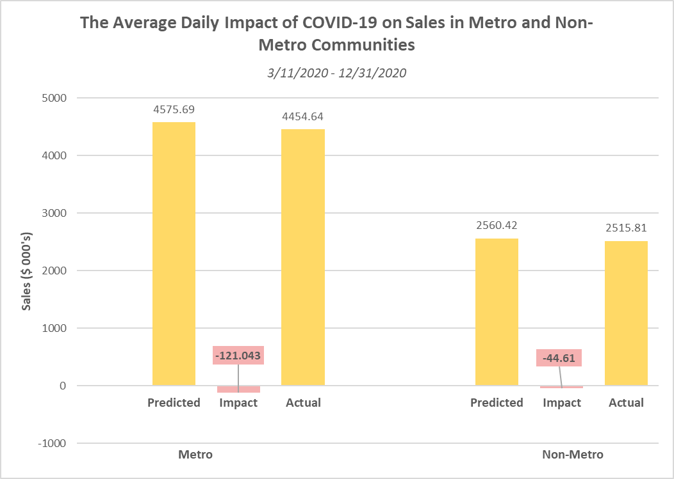


Assessing the Impact of COVID-19 on Metro vs. Non-Metro Communities
Non-Metro areas demonstrate a lower average daily impact despite having higher total impact due to more COOPs
$121K
Utilizing average daily sales, the impact of COVID on metro areas was approximately 121K in losses. In aggregate, given its respective share of the store count, metro areas generated a total loss of 179M. Greater average daily impact in metro areas can be attributed to increased COVID restraints and regulations in these communities.
$44K
While non-metro areas have a smaller store count, they account for a large portion of the data, given that more stores fall in this segment. As a result, the total impact of this segment was 198M in losses, with an average daily loss of 44K.
Implications and Recommendations
Recommendation 1
Recommendation 2
Recommendation 3
Background
COVID Impact
Ad Assessment
Recommendations
Notes:
By segmenting COOPs locations as part of either metro or non-metro communities, we found that the average daily impact of COVID on sales was almost 3x greater in metro communities compared to non-metro areas.
In aggregate, given its respective share of the total store count, this means that metro COOP locations generated a total loss of 179M over the course of COVID, and their greater average daily impact can be attributed to factors such as increased COVID regulations in those areas.
When examining the non-metro COOPs, we found that despite having a smaller store count, these areas account for a larger portion of the given dataset; quite simply, more COOPs are located in non-metro communities. Thus, despite their lower average daily losses, non-metro areas ultimately generated greater total losses as a result of COVID than non-metro communities.
When it comes to combining both of our segmentation analyses, it appears that McDonalds has more metro hubs in the Midwest (in areas such as Chicago, Ohio, and Michigan). These areas, on average, suffered smaller losses, but ended up aggregating to a larger total loss impact from COVID compared to non-metro McDonalds locations in the West.

Slide 11
Assessing the Impact of McDonald’s Advertising Campaigns
Notes:
Now that we have understood the overall impact of COVID on sales and examined the differences in impact across COOPs, I will pass it on to Jacob to address the influence of advertisement campaigns on sales.

Slide 12
Understanding Our Approach and Model: Multiple Regression Prediction Model
We developed a regression model to analyze weekly total sales as a function of binary advertising variables
Relationship to the Core Problem
The regression model posits weekly total sales against the number of advertisements run in a given week. By interpretation of the coefficients on independent variables, we can assess the impact of advertising on sales for metro and non-metro segments. Effectively, the coefficients represent the change in total weekly sales for each additional add run in a given week.
Model Inputs
Model
Machinery
Model Outputs
Our model uses several inputs including the number of ads run in this week, lagged binary ad variables, the mean unemployment rate, and quarterly dummy variables to account for seasonality
The multiple regression model derives the coefficients for each independent variable that minimizes the squared differences (residuals) between actual and predicted values for the training set
The model will predict weekly total sales as a function of the independent variables (inputs)
Background
COVID Impact
Ad Assessment
Recommendations

Slide 13
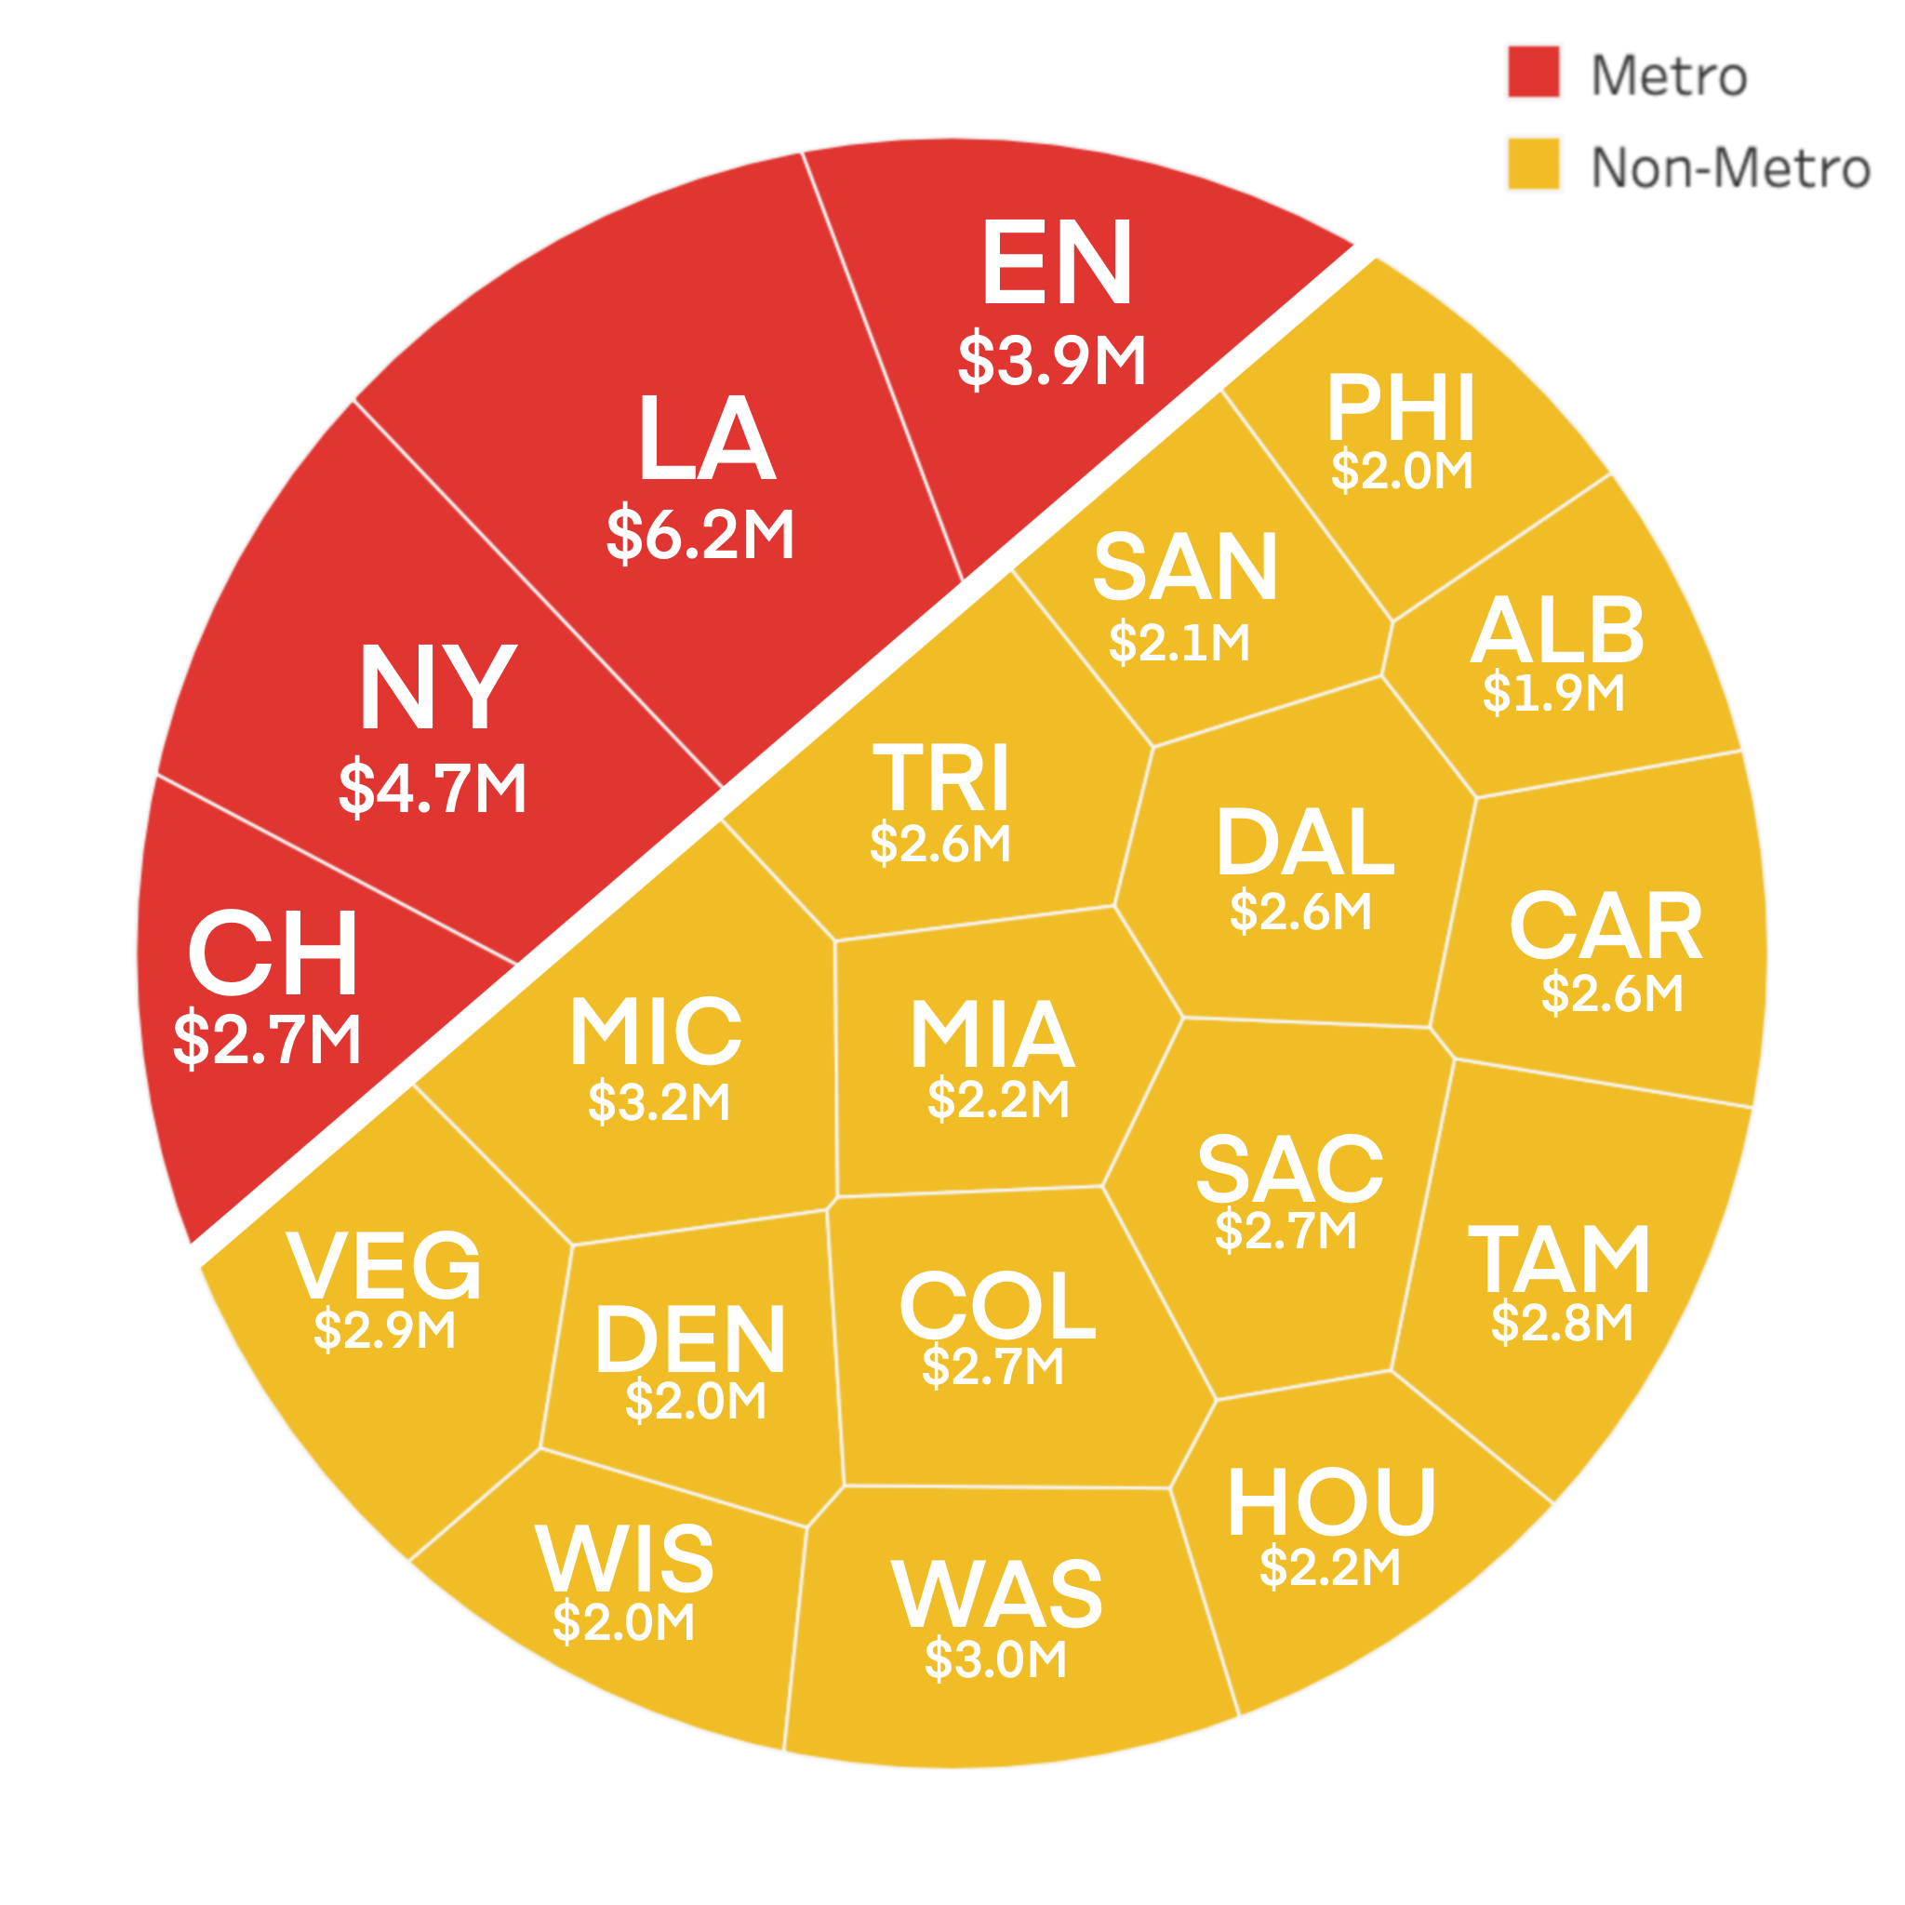
Segmentation of Metro vs. Non-Metro Areas For Tailored Geographic Solutions
We leveraged computer generated segments (hierarchy clustering) which resulted in metro vs. non-metro groups
COOP Segmentation by Community Type
Segmentation Strategy
Used hierarchy clustering model to generate clusters of COOPs by total sales
Our clustering model generated segments that allowed us to investigate the effects of advertising campaigns on metro versus non-metro COOP locations
This strategy would allow us to analyze key differences between COOPs consistently with our COVID-19 segmentation and provide tailored advertising recommendations
Background
COVID Impact
Ad Assessment
Recommendations

Slide 14
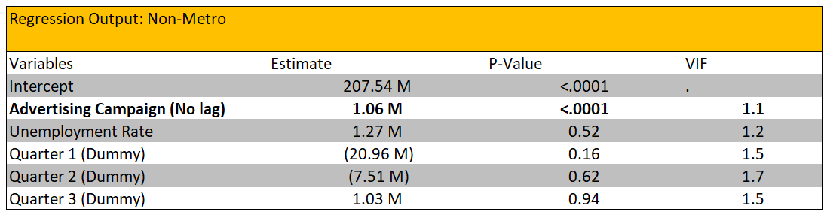
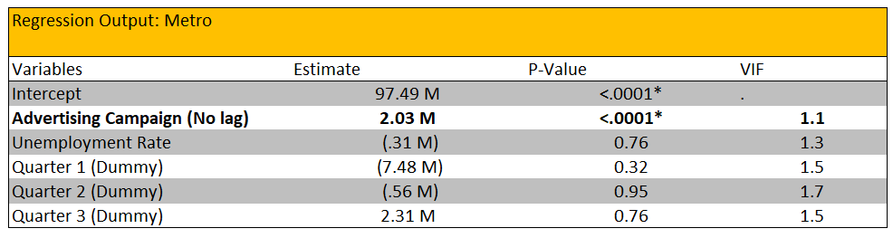
Advertisement Impact Analysis
Advertising appears to have ~2x the impact on total sales of metro COOP locations as compared to non-metro locations
$1.06M
For non-metro COOPs defined by our segmentation, it is estimated that launching an additional advertisement in a given week leads to a $1.06M increase in weekly sales for that week - a statistically significant result
$2.03M
Metro COOPs defined by our segmentation appear to demonstrate larger changes in sales in response to advertising with each additional ad resulting in $2.03M of additional weekly sales, which is statistically significant
Takeaways
Additional advertisement spending is not created equal and can be targeted at different groups to achieve different effects
Economic output appears to be insignificantly correlated so attempting to time advertising with market cycles may be moot
Background
COVID Impact
Ad Assessment
Recommendations

Slide 15
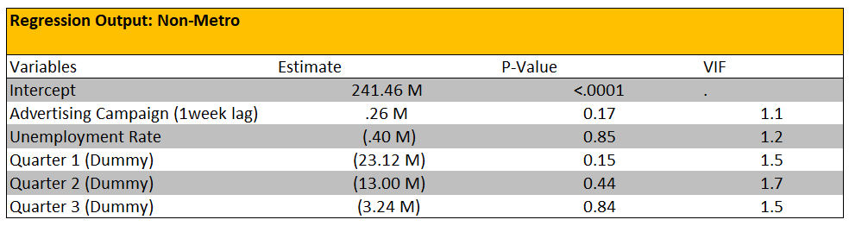
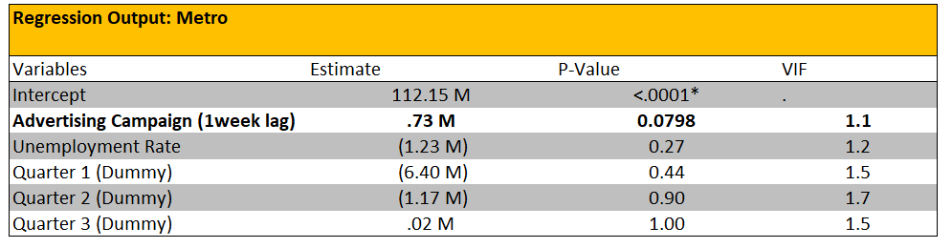
Advertisement Impact Analysis
We do not see an impact of advertising campaigns on sales by day 7 of the launch
Takeaways
By incorporating a lagged variable in our regression analysis, we find:
The impact of an advertising campaign on total sales generally lasts a few days
The coefficient of the lagged variable is not statistically significant, meaning that the effect of marketing campaign on sales generally phases out by the end of the week
What does this mean for McDonalds’ marketing department?
The marketing department should optimize the frequency of implementing advertising campaigns based on their effective duration
Background
COVID Impact
Ad Assessment
Recommendations

Slide 16
Key Client Takeaways

Slide 17




Key Client Takeaways
Overall Impact of COVID-19
COVID-19 Impact Across COOPs
We estimate total sales loss across all US COOPs as a result of COVID-19 to be approximately $377M
Across all regions, the Midwest faced the steepest decline in average daily losses, while the West had the most total losses
Advertising Influence
Regional Resiliency
Metro areas display an approximate 2x growth in sales in response to advertising compared to non-metro areas
Moving forward, McDonalds should keep in mind that its metro, West-coast COOP locations tend to be most resilient
Background
COVID Impact
Ad Assessment
Recommendations

Slide 18
Thank You!
We are glad to address any questions at this time

Slide 19
Appendix

Slide 20
Overview of Our Approach and Timeline
We engaged in a structured approach to understand the problem, derive a solution, and execute our plan
Week 3
Week 2
Week 1
Week 3 focused on developing a templated presentation, attempting various models, and considering pitfalls in our approach
Key Achievements
- Ghost deck of presentation slides
- Early advertising regression model
- Decision tree COVID-19 impact model
- Segmentation visualizations
Week 2 focused on gaining familiarity with the data set, learning about modeling solutions, and building a preliminary framework
Key Achievements
- Preliminary data cleaning plotting
- Understanding of key data trends
- Rough outline of project structure
Week 1 focused on understanding the problem and assessing high level solutions considering the skill set of each member
Key Achievements
- Problem breakdown
- Solution brainstorming
- Consideration of tools
- Skill sharing
Week 4
Week 5
Week 6
Week 4 focused refining the models to improve accuracy and explainability
Key Achievements
- Introduction of lags into regression model
- Seasonality variables added to regression
- Random Forest Model for COVID-19
- XGBoost Model for COVID-19
Week 5 focused on finalizing the models and developing the presentation
Key Achievements
- Background information slides completed
- Advertising regression model complete with lags, seasonality, and segmentation
- COVID-19 Impact Random forest model complete across all segments
- Visualizations developed for model output
Week 6 focused on finalizing the presentation and appendix
Key Achievements
- Core recommendations decided
- Presentation finalized
- Appendix completed with supplements

Slide 21
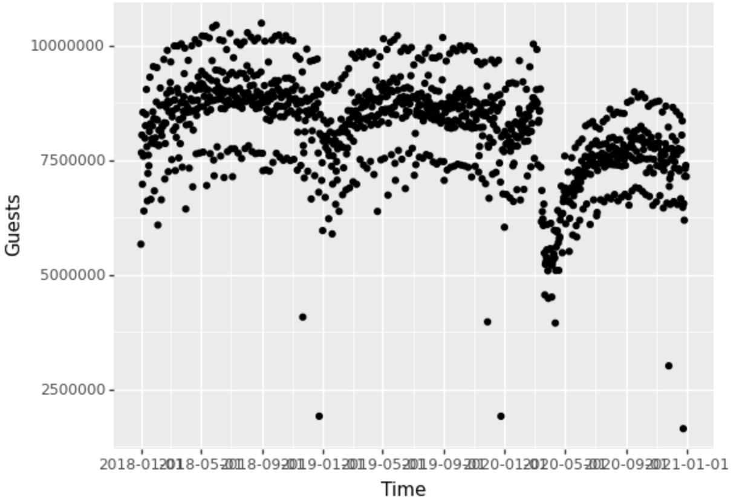
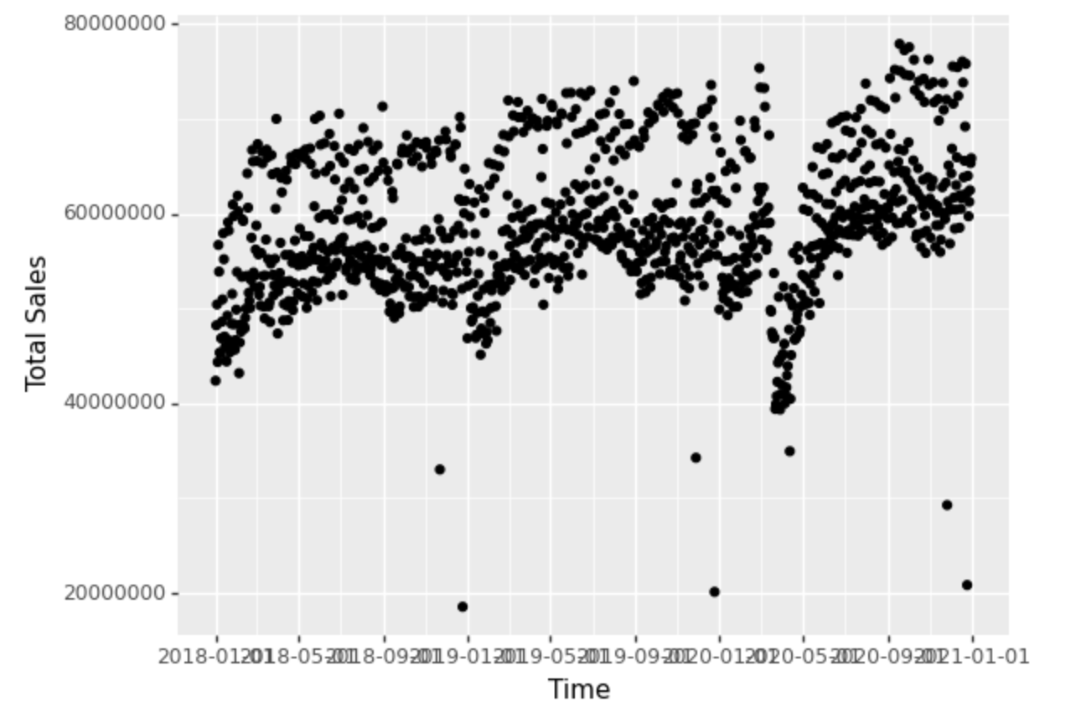
Understand High Level Data Trends
We plotted the original data set to observe overall trends of Guest Count and Total Sale Amount with respect to time
Observation: Guest Count
Median Pre-COVID: ~8,750,000
Median Post-COVID: ~7,500,000
Approximately 15% decrease in guest count.
Guest Count
Total Sale Amount
Observation: Total Sale Amount
Median Pre-COVID: ~60,000,000
Median Post-COVID: ~60,500,000
Approximately 8% increase in total sale amount.
Takeaway
We observed a significant decline in both Guest Count and Total Sale Amount in March 2020.
Both Guest Count and Total Sale Amount follow a consistent pattern in seasonality regardless of the pandemic.
As to the effect of COVID-19, we noted a more significant change in Guest Count (-15%) than Total Sale Amount (+8%).

Slide 22

Considerations for Data Segmentation
We considered several a-priori demographic segmentation options as well as segmentation by clustering
Geographic Region
Store Size
Total Sales
Our first attempt at segmentation focused on dividing COOPs based on geographic location.
Based on the resulting five regions, we planned to examine the impact of COVID-19 and advertising campaigns on a regional basis.
However, upon further analysis, it appeared that COOPs were more or less already grouped based on location, and that geographic segmentation would not allow us to analyze any impact as a result of store size.
Our second attempt at segmentation involved clustering by dividing COOPs based on the sizes of their stores, which allowed us to examine the effects of store size on total sales.
However, this clustering attempt grouped together seemingly different COOPs (e.g., the Chicago city COOP was in the same group with the Ohio state COOP).
Consequently, the implications from this analysis did not provide an accurate basis of comparison between metro and rural areas.
Our third attempt at segmentation used total sales to divide COOPs into similarly-sized regions based on total sales.
However, this segmentation method resulted in overfitting because we were segmenting and predicting the same variable (total sales).
In lieu of this segmentation method, we ultimately decided to cluster the COOPs as metro versus non-metro based on store count

Slide 23
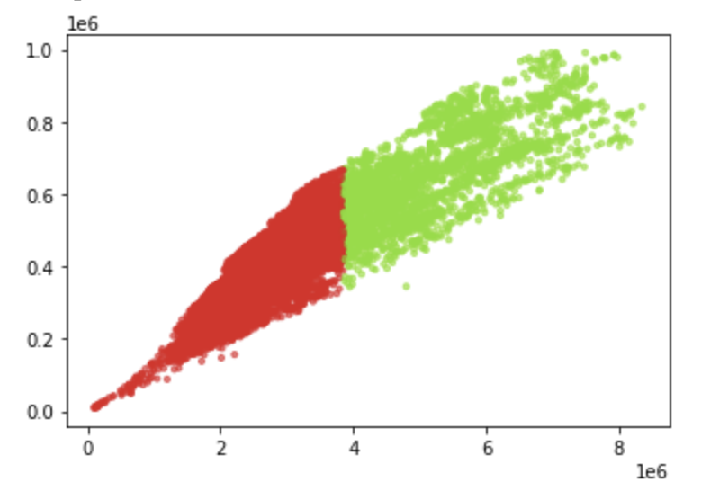
Considerations for Data Segmentation
We considered several a-priori demographic segmentation options as well as segmentation by clustering
Segmentation By Region Visualization
Clustering Model Segmentation Output
Key Observations
Variables highly correlated with one another
Seems to divide on mean
Does not account for categorical variables

Slide 24
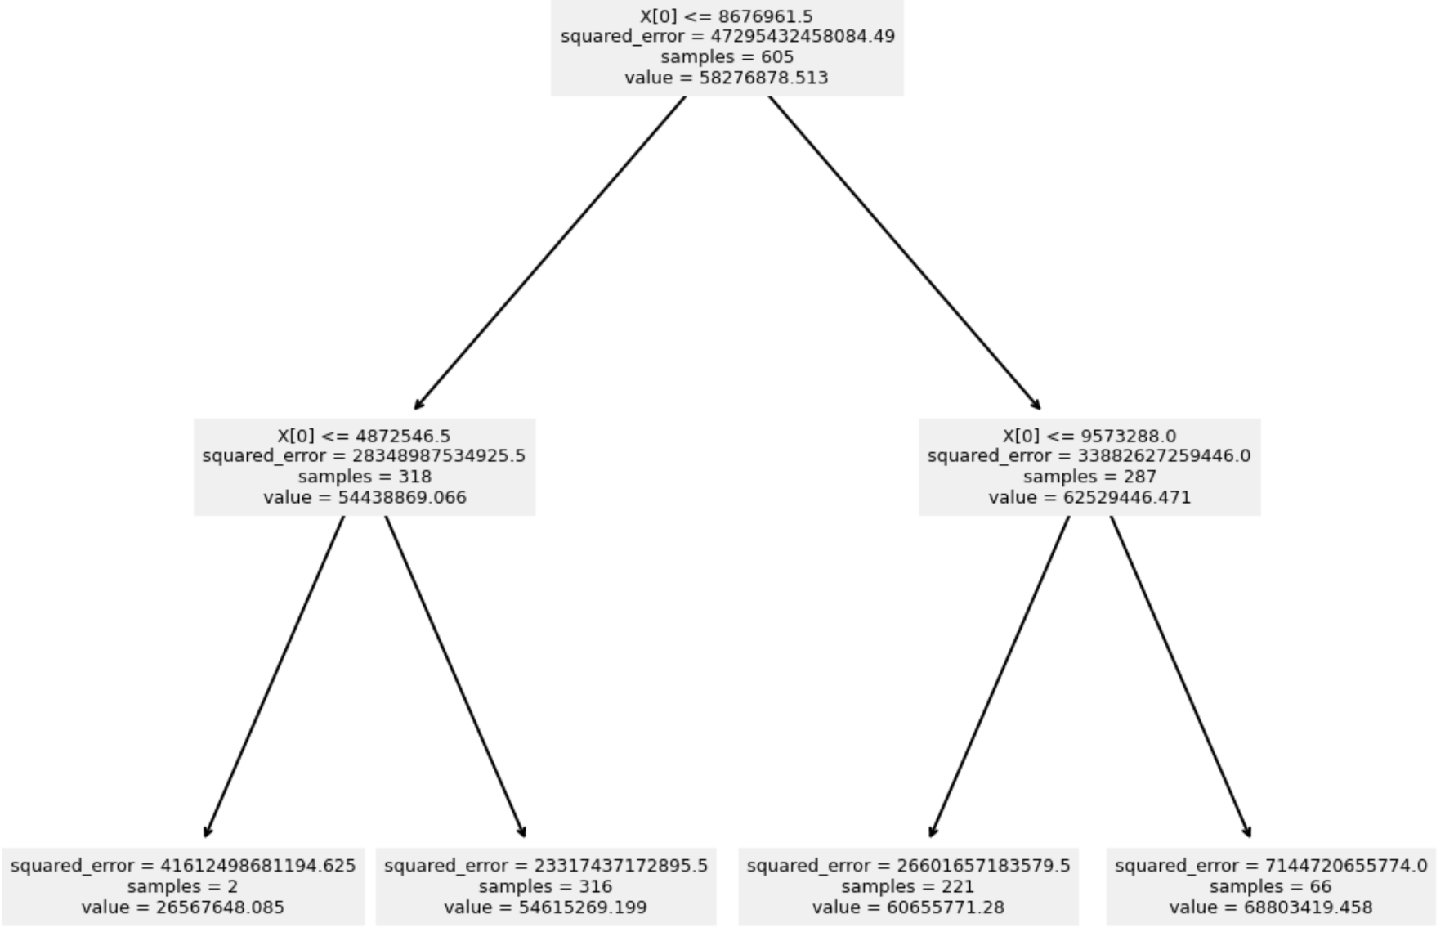
First Attempt At Modeling the Impact of COVID-19: Decision Tree Model
We first considered the use of a simple machine learning decision tree model to assess our first two tasks
Description of the Decision Tree Model
We ran the simple decision tree model on Pre-COVID sales data as an initial attempt to decide how to model the dataset.
Advantages to This Model
Simple to implement, captures some randomness, and provides intuitive outputs.
Disadvantages to This Model
Unstable as small changes in data can change the tree.
Inadequate for capturing data and making predictions over time.
Our Decision
For the disadvantages above, we felt prediction accuracy was highly important, so we decided to use a different model.

Slide 25
Second Attempt At Modeling the Impact of COVID-19: Random Forest Model
We considered the use of a random forest model to address the impact of COVID-19 on sales
Description of the Random Forest model
We separated the data set into Pre-COVID group and COVID group, then converted categorical data variables using one-hot encoding in Python. Using a test size of 0.2, we ran a random forest model on the training data and made prediction for testing data.
We performed an error calculation to find accuracy of our model outputs before further applying this model to the COVID data and making final predictions.
Advantages to This Model
Reduces overfitting in decision trees, flexible to both categorical and continuous variables, and utomates missing value in dataset.
Disadvantages to This Model
Model Output on the next slide
Susceptible to overfitting with an increase in inputs.
Our Decision
Similar to the decision tree model, we value our prediction accuracy highly and decided to adopt a different model.

Slide 26
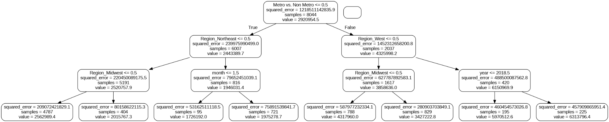
Second Attempt At Modeling the Impact of COVID-19: Random Forest Model
We considered the use of a random forest model to address the impact of COVID-19 on sales

Slide 27
First Regression Attempt: Using Non-Binary Impressions as Dependent Variable
Our first regression attempt used impressions as a core dependent variable, which left uninterpretable results
Core Problem
Initial Model
Solution
We felt this model did not produce results that were sufficiently interpretable nor easily identifiable. The impression variable also had much noise as it did not account for users skipping ad posts
Determine whether an advertisement was ran on a given day (binary variable). Sum by week: The number of ads ran in a week
(Non-metro: 1.56M
Metro: 2.9M)
Use impressions as key independent variables to daily sales with no lagged effects
Relationship to the Core Problem
By changing to binary advertising data and aggregating sales weekly, we would be able to identify how introducing one new advertisement would influence weekly sales (independent variable coefficient). We felt this would provide for more actionable recommendations that were directly in control of the company (as opposed to trying to drive up impressions).

Slide 28
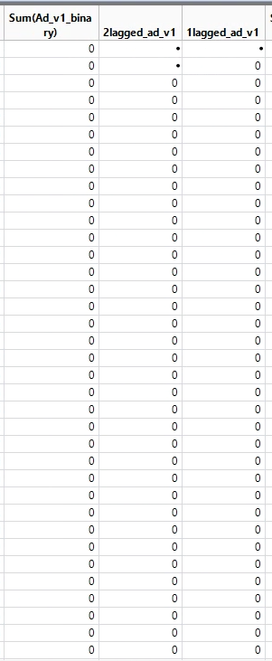
Advertising’s Delayed Effects: Incorporating Lag Variables
To account for the potential delayed effects of advertising, we introduced lagged variables into the regression
Why Lagged Variables?
The effect of advertising is unlikely to be instantaneous
Lagged variables help captured the delayed effects that come with advertising
With binary advertising variables, lagged variables can tell us how much future sales will be impacted by launching an additional advertisement
Creating 1 and 2 Week Lags
Our Approach
Tested 1 week, 2 week, and 3 week lags in the multiple regression model
We aggregated data weekly and found that the weekly lags were statistically insignificant
Key synthesis: the effect on advertising may be most prominent within a few days of the ad being launched

Slide 29
Advertising Regression: Accounting for Seasonality
We incorporated quarterly seasonality variables to address cyclical trends
Why Seasonality?
Seasonality variables allow us to account for the regular fluctuations in our output variable that vary cyclically over time.
Our Approach
Incorporate quarterly seasonality variables using Q1, Q2, and Q3 dummy variables. None of the seasonality variables demonstrate statistical significance- a sign that daily sales are non-seasonal.

